Slide 1
Beginning Programming
Symbolic Math Toolbox
Learning goals:
  Understand the difference between numeric and symbolic computing.
  Learn about the capabilities of the symbolic math toolbox.
  Practice using the symbolic math toolbox, transitioning between symbolic and numeric computations.

Slide 2
What is Symbolic Math?
Symbolic mathematics are commands deal with equations before you plug in the numbers.
  Calculus – integration, differentiation, Taylor series expansion, …
  Linear Algebra – inverses, determinants, eigenvalues, …
  Simplification – algebraic and trigonometric expressions
  Equation Solutions – algebraic and differential equations
  Transforms – Fourier, Laplace, Z transforms and inverse transforms, …

Slide 3
Matlab's Symbolic Toolbox
  The Symbolic Toolbox allows one to use Matlab for symbolic math calculations.
  The Symbolic Toolbox is a separately licensed option for Matlab. (The license server separately counts usage of the Symbolic Toolbox.)
  Recent versions use a symbolic computation engine called MuPAD. Older versions used Maple. Matlab translates the commands you use to work with the appropriate engine.
  One could also use Maple or Mathematica for symbolic math calculations.
  Strategy: Use the symbolic toolbox only to develop the equations you will need. Then use those equations with non-symbolic Matlab to implement your program.

Slide 4
Symbolic Objects
Use sym to create a symbolic number, and double to convert to a normal number.
>> sqrt(2)
ans = 1.4142
>> var = sqrt(sym(2))
var = 2^(1/2)
>> double(var)
ans = 1.4142
>> sym(2)/sym(5) + sym(1)/sym(3)
ans = 11/15

Slide 5
Symbolic variables
Use syms to define symbolic variables. (Or use sym to create an abbreviated symbol name.)
>> syms m n b c x
>> th = sym('theta')
>> sin(th)
ans = sin(theta)
>> sin(th)^2 + cos(th)^2
ans = cos(theta)^2 + sin(theta)^2
>> y = m*x + b
y = b + m*x

Slide 6
Substituting into symbolic expressions
The subs function substitutes values or expressions for variables in a symbolic expression.
>> clear
>> syms m x b
>> y = m*x + b → y = b + m*x
>> subs(y,x,3) → ans = b + 3*m
>> subs(y, [m b], [2 3]) → ans = 2*x + 3
>> subs(y, [b m x], [3 2 4])→ ans = 11
The symbolic expression itself is unchanged.
>> y → y = b + m*x

Slide 7
Substitutions, continued
Variables can hold symbolic expressions.
>> syms th z
>> f = cos(th) → f = cos(th)
>> subs(f,pi) → ans = -1
Expressions can be substituted into variables.
>> subs(f, z*pi) → ans = cos(pi*z)

Slide 8
Differentiation
Use diff to do symbolic differentiation.
>> clear
>> syms m x b th n y
>> y = m*x + b;
>> diff(y, x) → ans = m
>> diff(y, b) → ans = 1
>> p = sin(th)^n → p = sin(th)^n
>> diff(p, th) → ans = n*cos(th)*sin(th)^(n - 1)

Slide 9
Integration
>> clear
>> syms m b x
>> y = m*x + b;
Indefinite integrals
>> int(y, x) → ans = (m*x^2)/2 + b*x
>> int(y, b) → ans = (b + m*x)^2/2
>> int(1/(1+x^2)) → ans = atan(x)
Definite integrals
>> int(y,x,2,5) → ans = 3*b + (21*m)/2
>> int(1/(1+x^2),x,0,1) → ans = pi/4

Slide 10
Solving algebraic equations
>> clear
>> syms a b c d x
>> solve('a*x^2 + b*x + c = 0')
→ ans = % Quadratic equation!
-(b + (b^2 - 4*a*c)^(1/2))/(2*a)
-(b - (b^2 - 4*a*c)^(1/2))/(2*a)
>> solve('a*x^3 + b*x^2 + c*x + d = 0')
→ Nasty-looking expression
>> pretty(ans)
→ Debatable better-looking expression
From in-class 2:
>> solve('m*x + b - (n*x + c)', 'x') → ans = -(b - c)/(m - n)
>> solve('m*x + b - (n*x + c)', 'b') → ans = c - m*x + n*x
>> collect(ans, 'x') → ans = c - x*(m - n)

Slide 11
Solving systems of equations
Solve Equations You can solve different types of symbolic equations including: • Algebraic equations with one symbolic variable • Systems of algebraic equations
1- Algebraic equations with one symbolic variable
>> syms x
>> solve(x^3 - 6*x^2 == 6 - 11*x)
ans = 1
2
3
2- Solve Algebraic Equations with Several Symbolic Variables
>> syms x y
>> solve (x+2*y ==0 , y)
ans =
-x/2

Slide 12
Solving systems of equations
Solve Equations You can solve different types of symbolic equations including: • Algebraic equations with one symbolic variable • Systems of algebraic equations
3- Solve Systems of Algebraic Equations.
>> [x, y] = solve('x^2 + x*y + y = 3', ...
'x^2 - 4*x + 3 = 0')
→ Two solutions: x = [ 1 ; 3 ]
y = [ 1 ; -3/2 ]
>> [x, y] = solve('m*x + b = y', 'y = n*x + c')
→ Unique solution: x = -(b - c)/(m - n)
y = -(b*n - c*m)/(m - n)
If there is no analytic solution, a numeric solution is attempted.
>> [x,y] = solve('sin(x+y) - exp(x)*y = 0', ...
'x^2 - y = 2')
→ x = -0.66870120500236202933135901833637
y = -1.5528386984283889912797441811191

Slide 13
Solving linear equations:
Find x,y,z in the following equations:
x+3*y-z = 2
x-y+z=3
3*x-5*y=4
>> syms x y z
>> [x,y,z] = solve ('x+3*y-z = 2','x-y+z=3','3*x-5*y=4')

Slide 14
Inline , factorial, pretty,
>> f=inline (‘x^2 +2 *x’, ‘x’)
X^2+2X
>> pretty (f)
>> f (4)
24
>> factorial (5)
120
>> poly2sym([1 2 3]) or a= poly2sym([1 2 3])
x^2 +2 x +3
>> sym2poly(ans) or sym2poly(a)
1 2 3

Slide 15
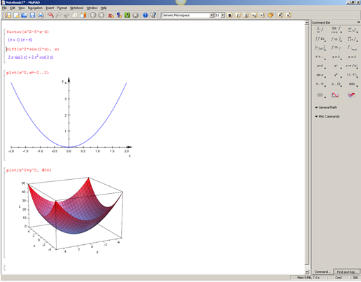
Mupad: subprogram in Matlab, MUPAD consists of a powerful symbolic engine, a language that is optimized for operating on symbolic math expressions, and an extensive set of mathematical functions and libraries…command bar, plot, general math
>>mupad
Integrate, factor, differentiate
[ int (x^2-2*x, x=-2..2)
[factor (x^2-5*x-6)
(x+1)(x-6)
[diff(x^2*sin(2*x),x)
[Simplify(x-2)*(x+3)
x^2 +x-6
[plot(x^2,x=-2..2
[plot (x^2 +y^2,#3d)

Slide 16
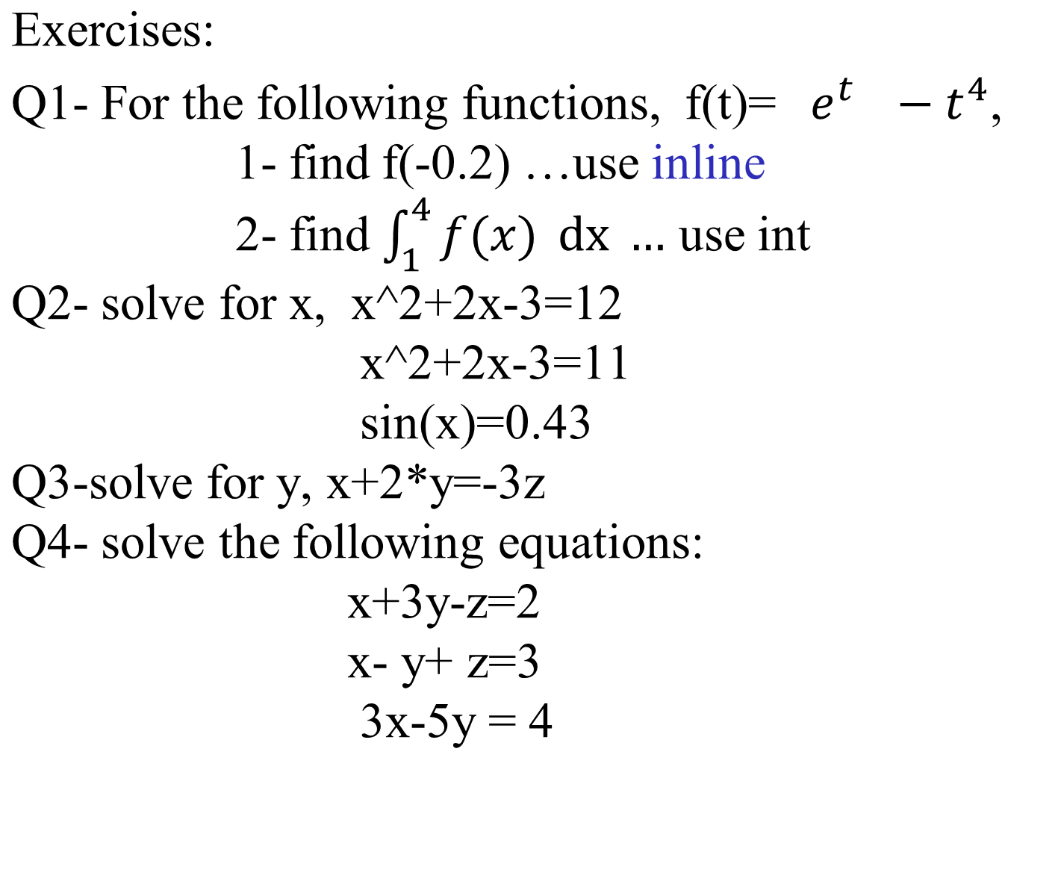
Q5- Plot the function 3^x -3x for the interval[-2,4]

Slide 17
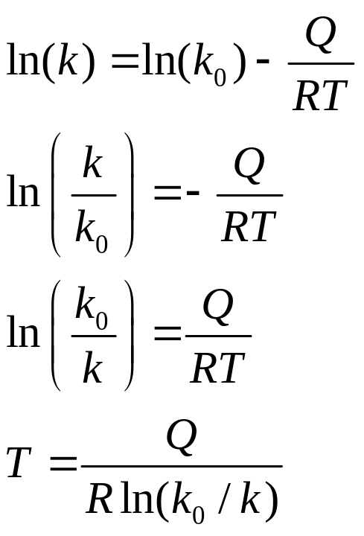
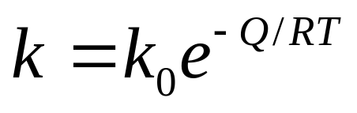
MATLAB’s symbolic capability allows you perform the simplification, or to manipulate the numerator and denominator separately
It is powerful to solve relationships that are not always easy to solve, examples:
>> E=sym('k=k1*exp(-q/(r*t))')
>> t=solve(E,'t')
-q/(r*(log(k/k1) + pi*l*2i))
imaginary term is added because k/k1 could be negative
MATLAB’s symbolic capability makes it easy to solve this problem

Slide 18
Creating Symbolic Variables
Two approaches
  Use the sym command to create
    Single variable
    Expression
    Equation
  Use the syms command to create
    Single variables
    Compose expressions and equations from the variables you’ve defined

Slide 19
Here is an example
Define x as a symbolic variable
  >> x=sym('x') or
  >> syms x
Use x to create a more complicated expression
  y = 2*(x+3)^2/(x^2+6*x+9)

Slide 20
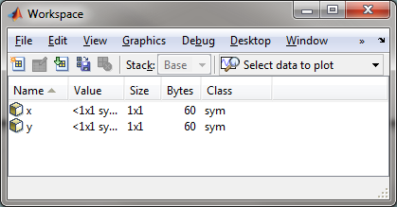
x and y are both symbolic variables

Slide 21
factor : factor can take a positive integer, an array of symbolic expressions, or an array of symbolic integers as an argument. If N is a positive integer, factor(N) returns the prime factorization of N.
>> syms x
>> y=x^2-3*x +2 y = x^2 - 3*x + 2
>> factor (y) ans =
(x - 1)*(x - 2)
>> expand (ans)
>> x^2-3*x +2
>> factor (15)
3 5

Slide 22
numden, factor, expand
>> E=sym('x^2/(2*(x^2-4))')
E =x^2/(2*x^2 - 8)
>> [num den]=numden(E)
num =x^2
den = 2*x^2 - 8
>> factor(den)
ans =2*(x - 2)*(x + 2)
>> expand(ans)
ans =2*x^2 – 8
>>solve(E)…..?

Slide 23
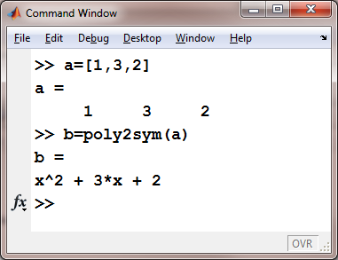
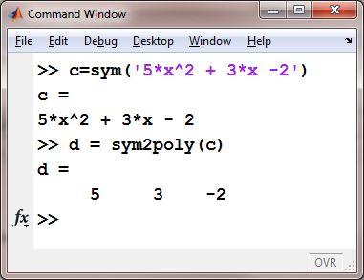
Use the poly2sym function as a shortcut to create a polynomial

Slide 24
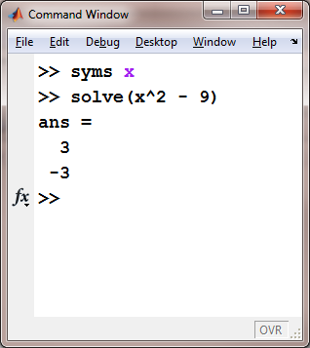
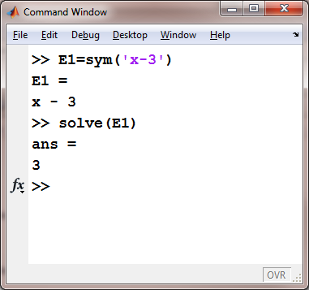
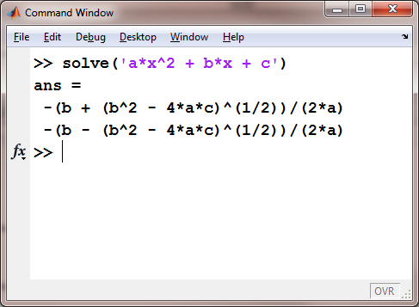
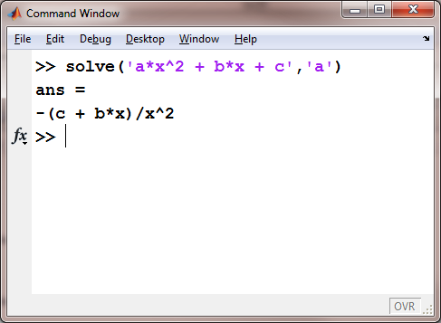
Solving Equations and Expressions

Slide 25
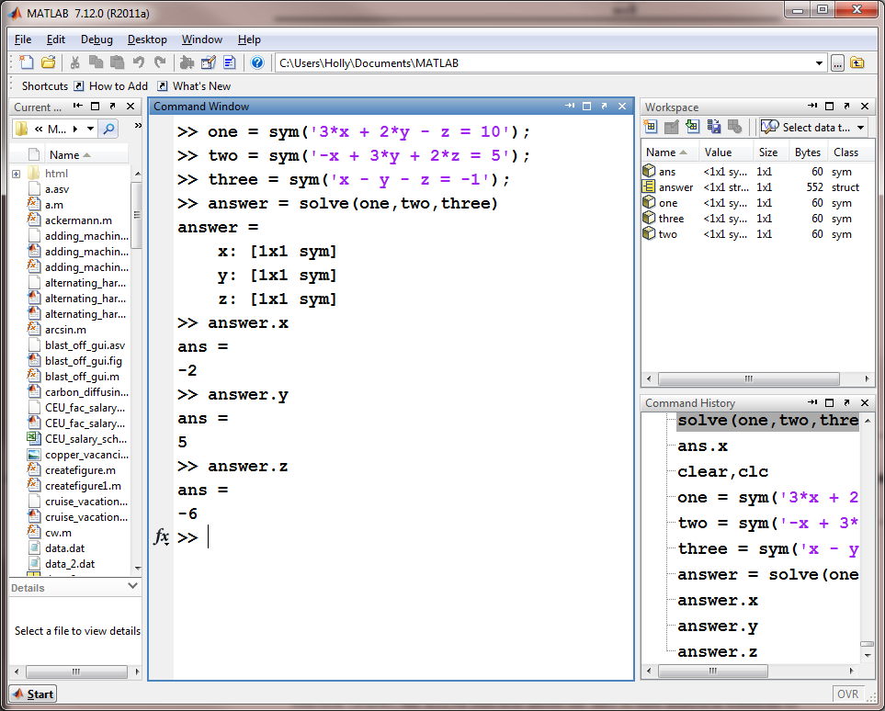

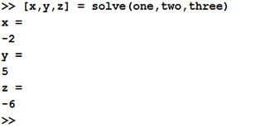

Slide 26
Using Matrix in Symbolic toolbox
    >> rand
    0.817
    >>rand(1,3)
    0.946 0.743 0.899
    >>syms X A B Y
    >> A=[X^2 X-3; X^2-X X]
    A=
    [ X^2, X - 3]
    [ X^2 - X, X]
    >> B= [X Y; X^2 Y^2]
    B =
    [ X, y]
    [ X^2, y^2]
A-B, A.*B, A+B, A./B, det(A), inv(A), A’, trace(a)

Slide 27
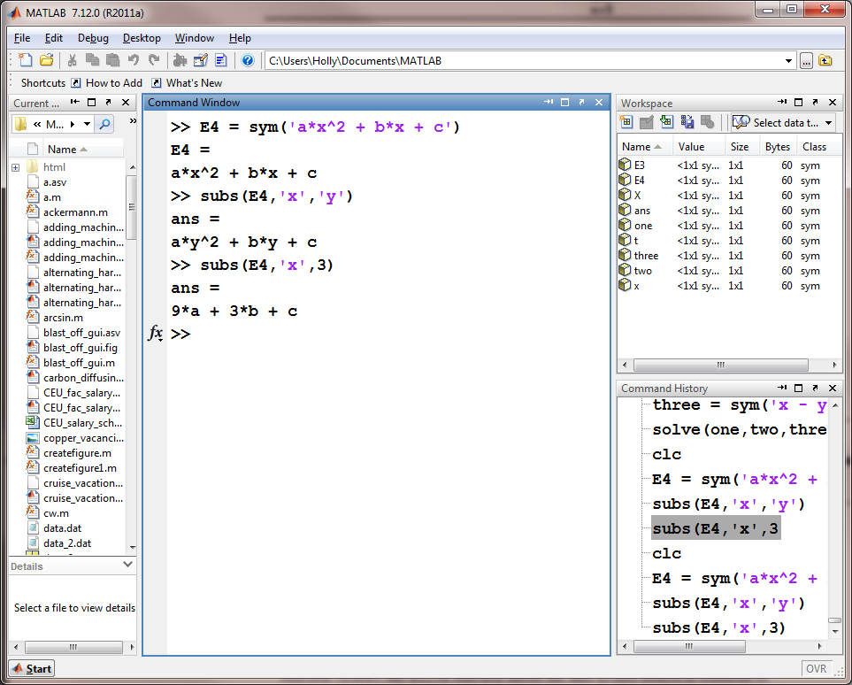
Substitution

Slide 28
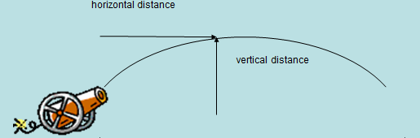
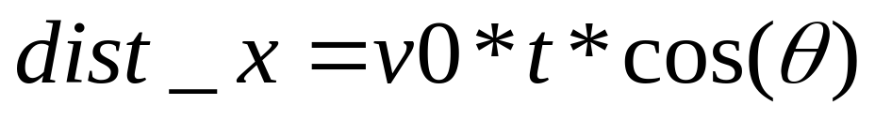
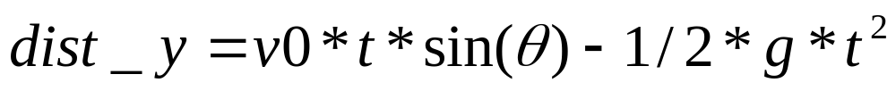
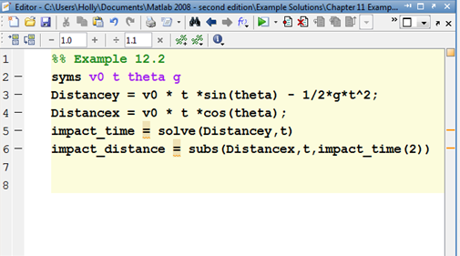
Example: Using Symbolic Math to solve a ballistics problem

Slide 29
>> syms v t th g
>> disty=v*t*sin(th)-1/2*g*t^2
>> distx=v*t*cos(th)
>> impact_time=solve(disty,t)
0 , (2*v*sin(th))/g
>> impact_distance=subs(distx,t,impact_time(2))
impact_distance=
v*impact_time(2)*sin(th) - (g*impact_time(2)^2)/2

Slide 30
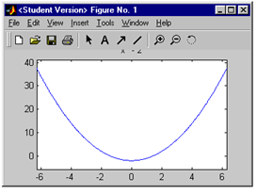

Symbolic Plotting: EZPlot
Allows you to plot symbolic expressions
ezplot(S)
  Defaults to a range of -2π to +2π
ezplot(S, [xmax, xmin])

Slide 31
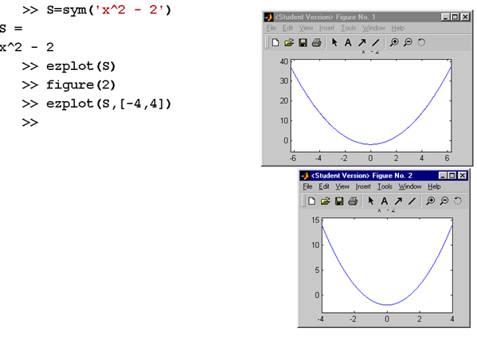
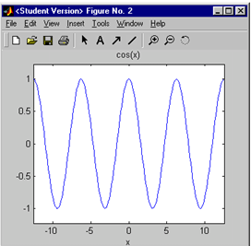

Slide 32
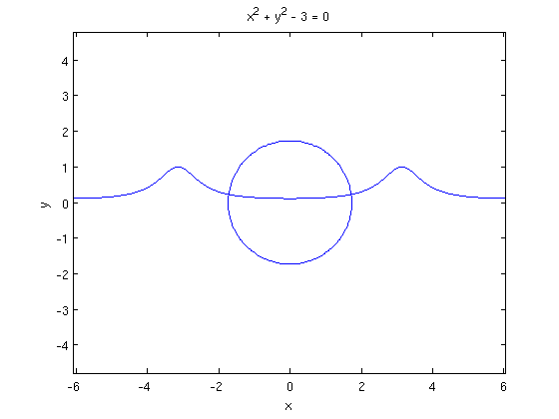
Plotting symbolic expressions
The ezplot function will plot symbolic expressions.
>> clear; syms x y
>> ezplot( 1 / (5 + 4*cos(x)) );
>> hold on; axis equal
>> g = x^2 + y^2 - 3;
>> ezplot(g);

Slide 33
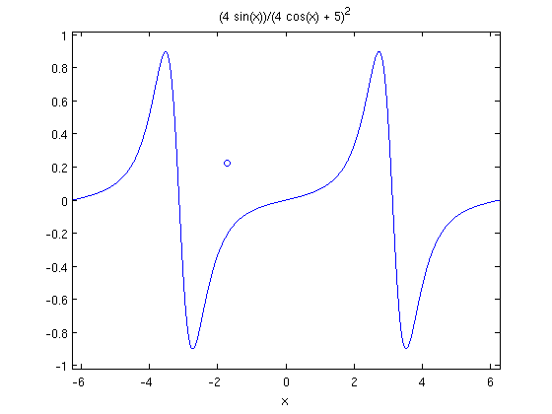
More symbolic plotting
>> clear; syms x
>> digits(20)
>> [x0, y0] = solve(' x^2 + y^2 - 3 = 0', ...
'y = 1 / (5 + 4*cos(x)) ')
→ x0 = -1.7171874987452662214
y0 = 0.22642237997374799957
>> plot(x0,y0,'o')
>> hold on
>> ezplot( diff( 1 / (5 + 4*cos(x)), x) )

Slide 34
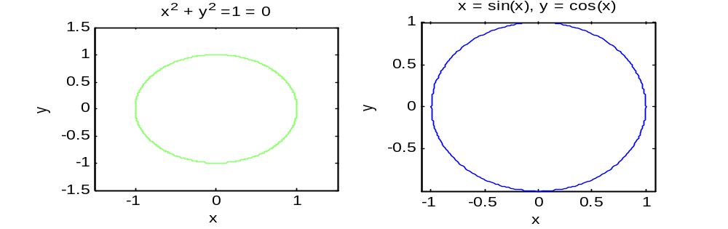
The equation for a circle can be expressed implicitly as:
  x² + y² = 1
You could solve for y, but it’s not necessary with ezplot
ezplot('x^2 + y^2 =1',[-1.5,1.5])
OR
The equation for a circle can be expressed parametrically as:
  x=sin(t)
  y=cos(t)
To create the graph use…
  ezplot(‘sin(x)’,’cos(x)’)

Slide 35
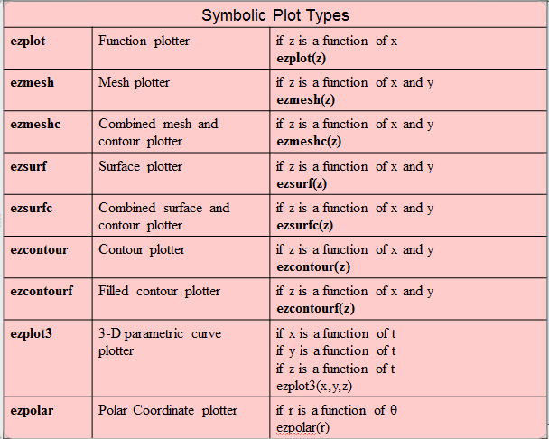
Other Symbolic Plots

Slide 36
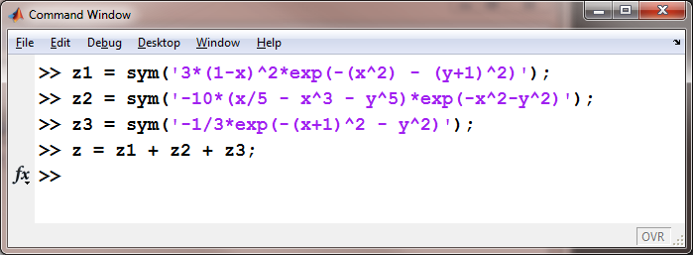
To demonstrate these plot types create a symbolic version of “peaks”

Slide 37
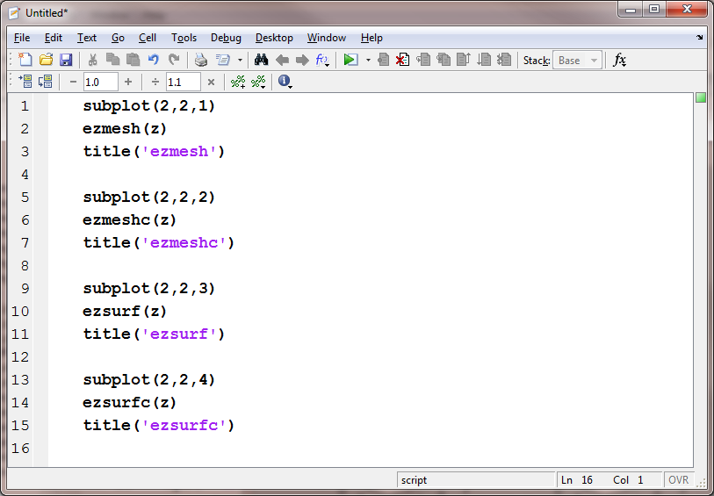

Slide 38
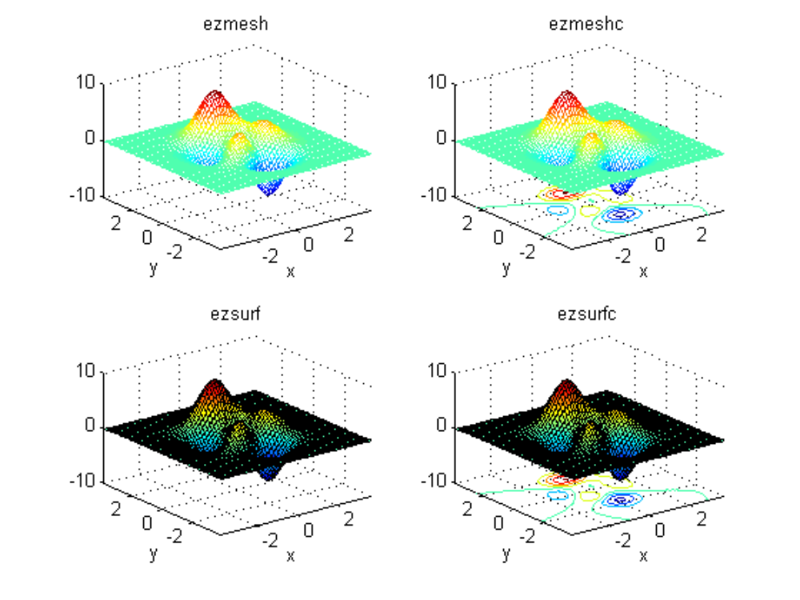

Slide 39
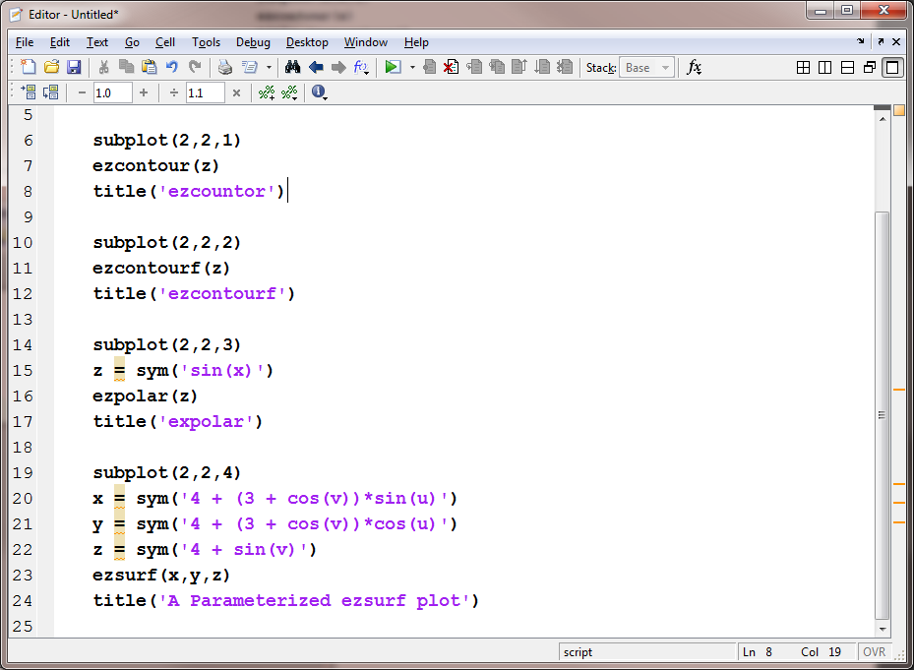

Slide 40
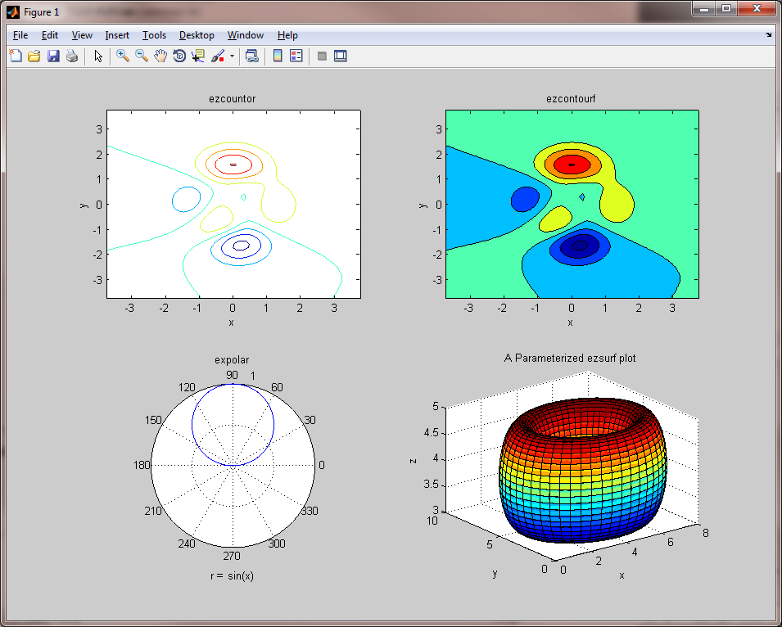

Slide 41
What is the contour?
The intersection of the horizontal plan z=k with the surface z=f(x, y) is called the contour curve of height K. The vertical projection of this contour curve into the x=y plan is the level curve F(x,y) =K
The 2D diagram representing typical level curve is called a contour plot of the function.
For the function of 3 variable F(x, y, z), the projections of F(x,y,z)=k are called level surfaces
Ex: sketch first a contour plot and then graph F(x, y) = y^2 - x^2
>> ezcontour(y^2-x^2)
>> ezsurfc(y^2-x^2)
>> ezsurf( y^2-x^2)

Slide 42
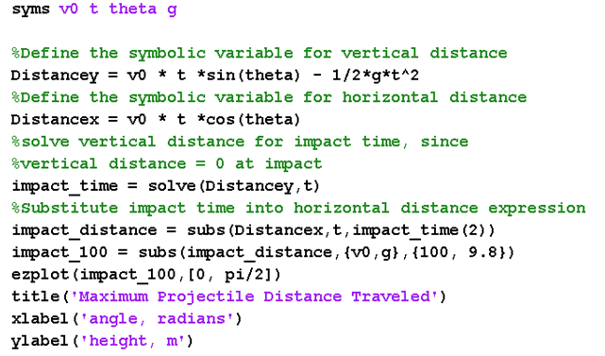
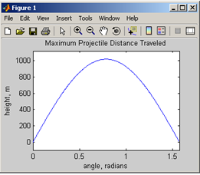
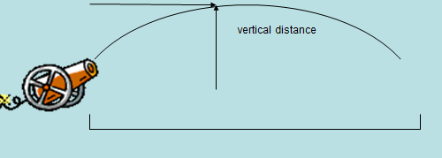
Example:
Plot the trajectory of a ballistic projectile, Assume 100 m/sec initial velocity, Assume g = 9.8 m/sec²

Slide 43
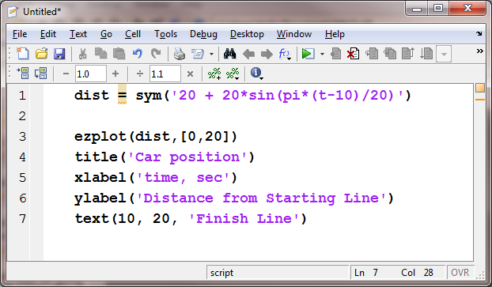
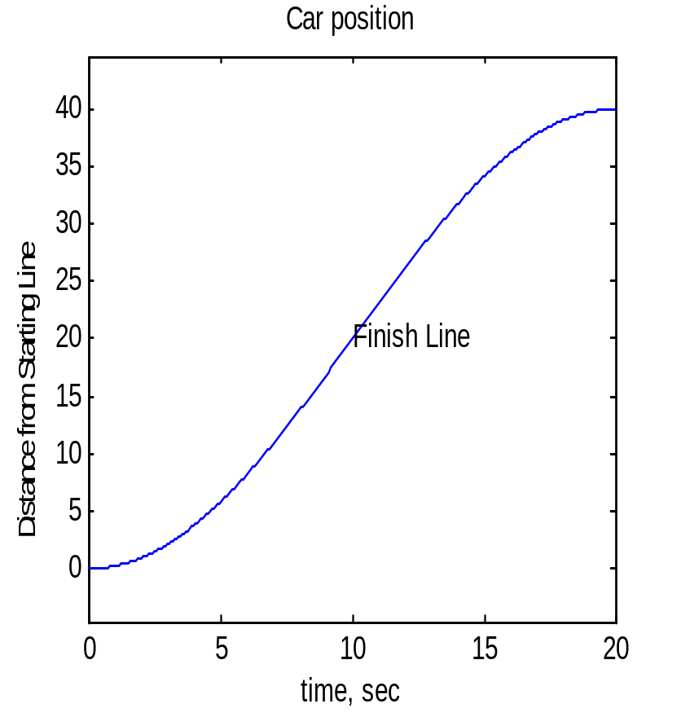
Example: Assume that during a race the car starts out slowly, and reaches its fastest speed at the finish line
To avoid running into the stands, the car must then slow down until it finally stops
We might model the position of the car using a sine wave :

Slide 44
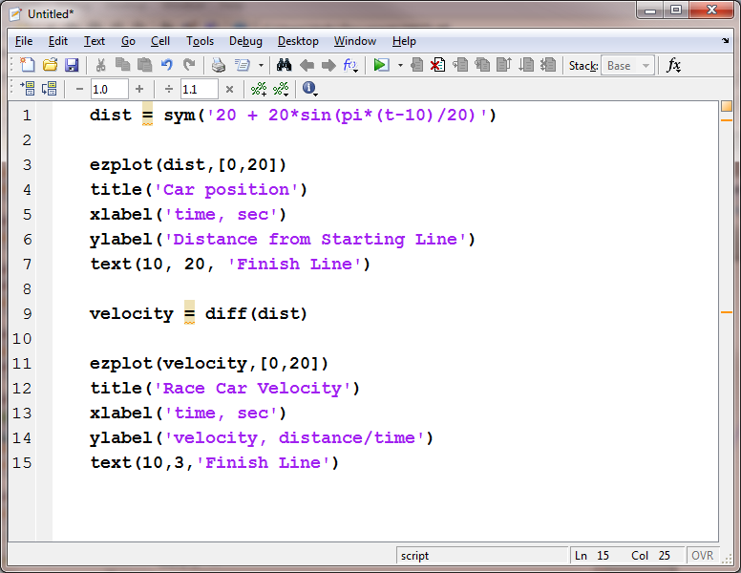
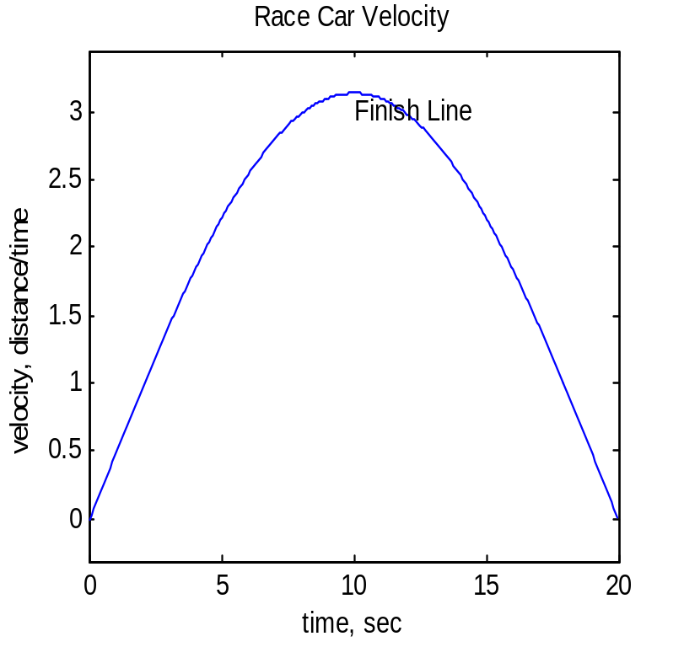
The velocity is the derivative of the position, so to find the equation of the velocity of the car we’ll use the diff function, then plot the result

Slide 45
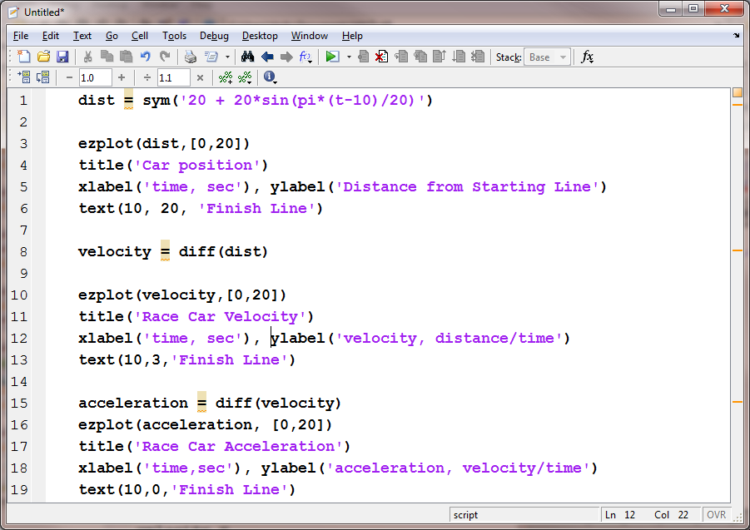
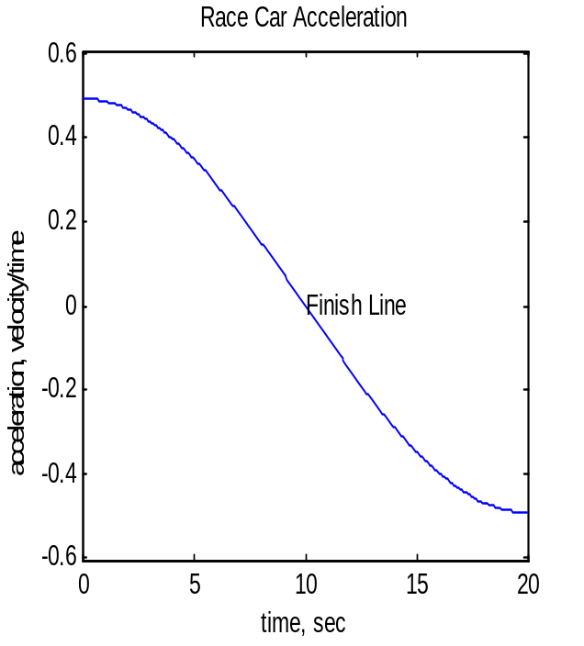
The acceleration is the derivative of the velocity, so to find the equation of the acceleration of the car we’ll use the diff function, then plot the result

Slide 46
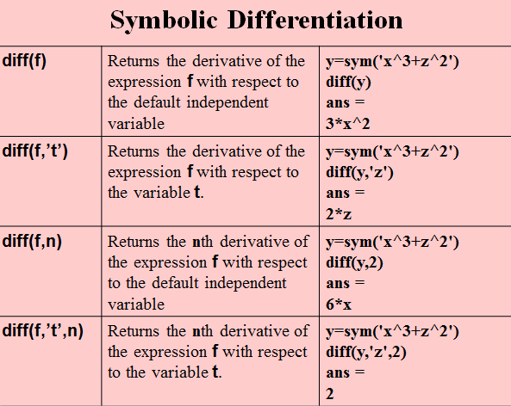

Slide 47
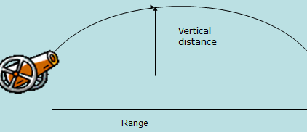
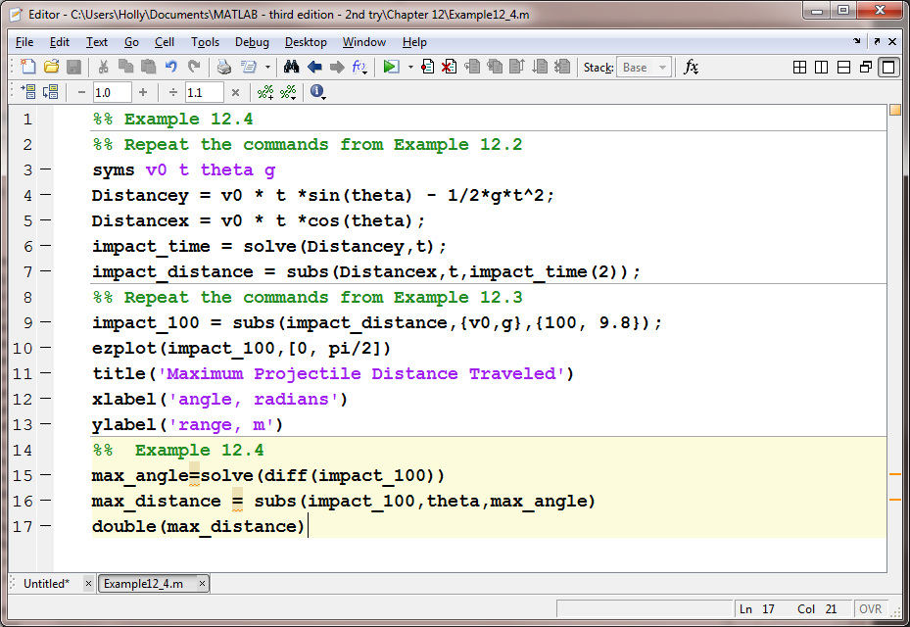
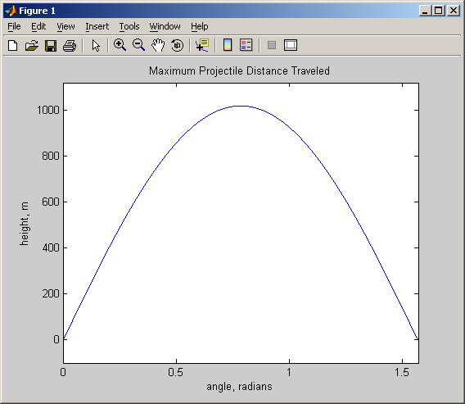
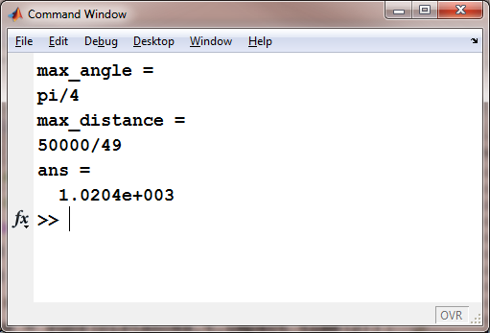
Example: Find the angle where the maximum range occurs Find the maximum range

Slide 48
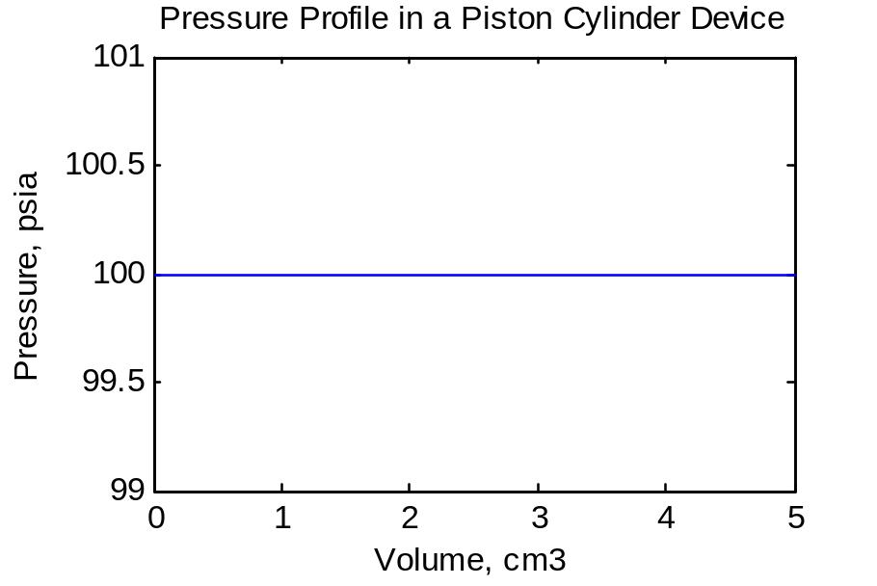
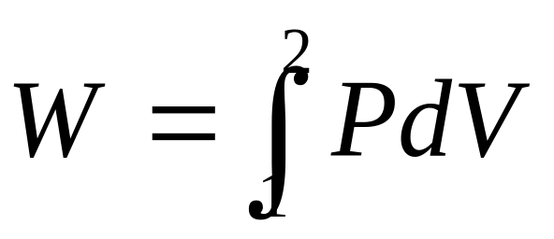
Consider a piston cylinder device
Work done by a piston cylinder device as it moves up or down, can be calculated by taking the integral of P with respect
gas
If p is constant =100 psi

Slide 49
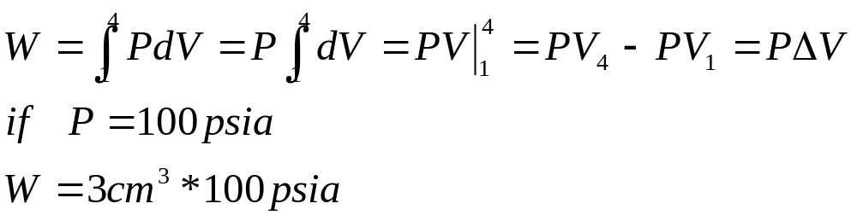
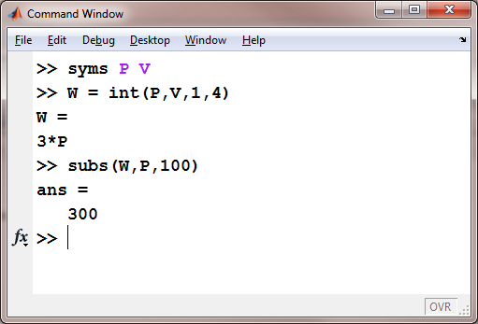

Slide 50
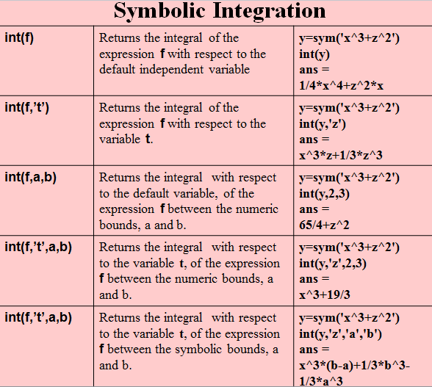

Slide 51

Solving differential equations
We want to solve:
Use D to represent differentiation against the independent variable.
>> y = dsolve('Dy = -a*y')
→ y = C5/exp(a*t)
Initial values can be added:
>> y = dsolve('Dy = -a*y', 'y(0) = 1')
→ y = 1/exp(a*t)

Slide 52
More differential equations
Second-order ODEs can be solved:
>> y = dsolve('D2y = -a^2*y', ...
'y(0) = 1, Dy(pi/a) = 0')
→ y = exp(a*i*t)/2 + 1/(2*exp(a*i*t))
Systems of ODEs can be solved:
>> [x,y] = dsolve('Dx = y', 'Dy = -x')
→ x = (C13*i)/exp(i*t) - C12*i*exp(i*t)
y = C12*exp(i*t) + C13/exp(i*t)

Slide 53
More Mupad
Test design➔ A notebook has three regions, input regions, output region and text region.
[plot(a*x^2,x=-1..1
Animating
The basic command is
Plotfunc2d(expression, domain) or
Plotfunc3d(expression, domain)
ex: plotfunc2d(4*x^2+2*x+8,x=-4..4)
Plotfunc3d(2*x^2+2*y^2,x=-4..4, y=-4..4)

Slide 54
more Mupad…..
[plot (plot:: Circle2d(3,[1,2])) % r=3, center=1,2
[plot::plot::VectorField2d(2*v+w, v-w, v=-2..2, w=-2..2))
[plot(plot::VectorField2d(2*v+w, v-w, v=-2..2, w=-2..2))
[plot(x/(2*x+2))
[plot(x^2-y^2, #3D)
[f:= (x-3)*(x+4)*(x+1)
[q:=expand(f) x^3 +2x^2 -11x-12
[plot(plot::Arrow3d([-1,-1,-1],[2,3,4]))
[plot(plot::Arrow2d([-3,-2],[3,4]))

Slide 55
Exercises:
Q1- Determine the points(s) where the function x^2+2x-3 has a horizontal tangent line. (use the plot and the symbolic command) …use solve, plot in mupad
Q2- Factor and solve x^2+6*x+9/(x^2-9)
Q3-Plot in 3 dimension the function sin(x). Sin2x
Q4- For f=(x-3)*(x+4)*(x+1) , Use Mupad to find the factor using the plot command and then using solve command. Plot the function in 3D
Q5- Find the limit for x^2 - 4*x – 5 when x=3
Q6- Find the limit from left to x=4 for the function 1/(x-4)

Slide 56
Function
function [ output_args ] = Untitled8( input_args )
%UNTITLED8 Summary of this function goes here
% Detailed explanation goes here
end
Example: Write add function to find the sumof three numbers.
function sum= add(a,b,c) sum =a+b+c; end | function plot_ez (a) ezplot (sin a*x); end

Slide 57
Answer for the limit questions
>> y =sym(‘x^2 - 4*x – 5’)
>> E14 = limit(y,’x’,3)
E14 =
-8
>> E15 = limit('1/(x-4)',x,4,'left')
E15 =
-Inf

